Slide 1
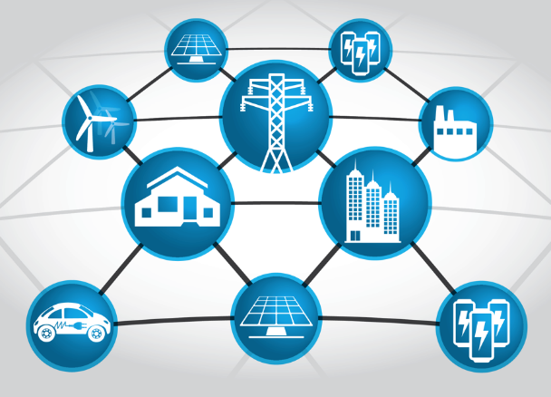
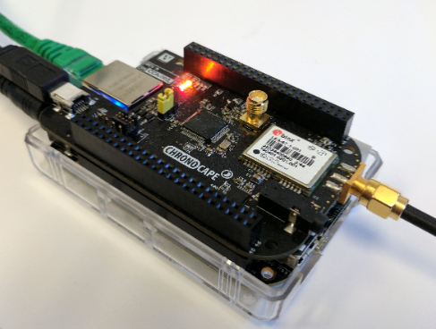


Resilient Computing Within Smart Grids - Information Architecture
Sponsored by ARPA-E under award DE-AR0000666
and Siemens Corporate Technology

Slide 2
The Context

Slide 3
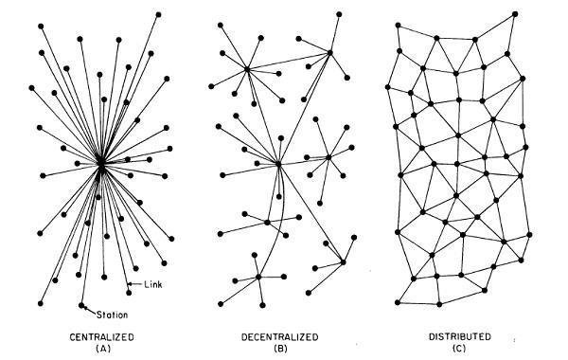
The Evolution of Energy Networks
Trend
Traditional networks with transmission system operators, distribution system operators, and radial distribution systems to communities
Network of distribution feeders with some microgrids with tightly integrated distributed energy resources
Network of transactive microgrids with limited role of distribution system operators

Slide 4
The Evolution of Energy Networks
Advantages of decentralization
improved cyber and physical resilience by removing single points of failures
faster decision making by avoiding network penalties due to round-trip to the cloud
improved scalability
better integration with hierarchical control systems
Traditional networks with transmission system operators, distribution system operators, and radial distribution systems to communities
Network of distribution feeders with some microgrids with tightly integrated distributed energy resources

Slide 5
VISION

Slide 6
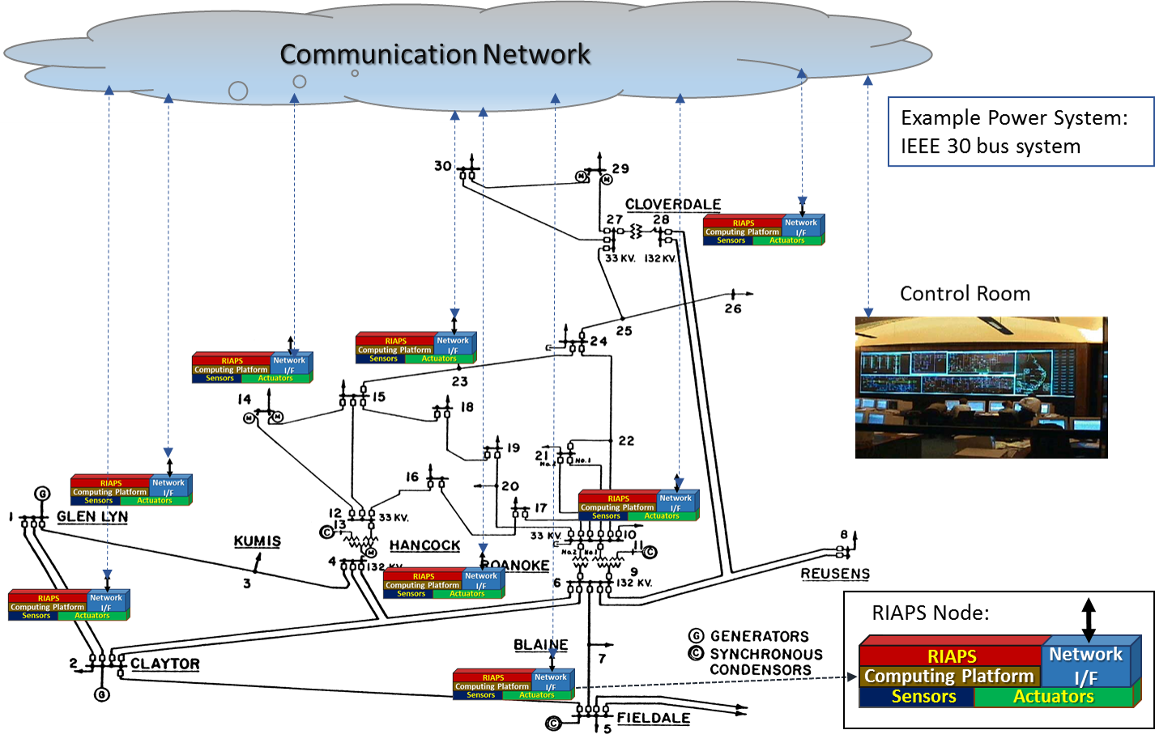
RIAPS Vision
Push computing, including monitoring and control to the edge.

Slide 7
RIAPS Vision
Provide core services to enable rapid development of smart apps.

Slide 8
Programming Model: key ideas

Slide 9
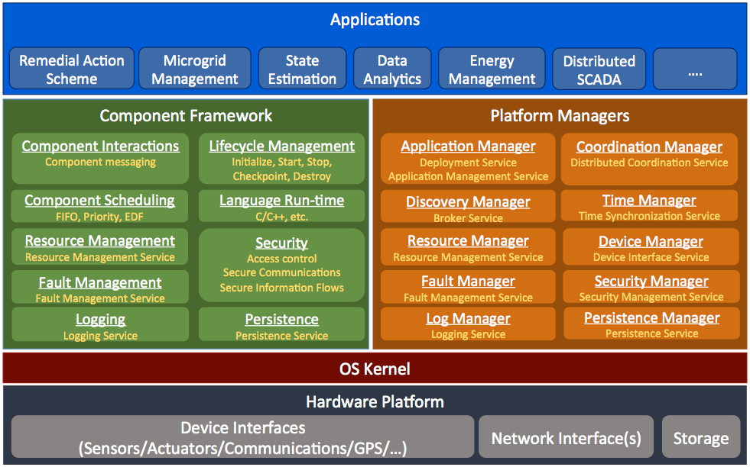
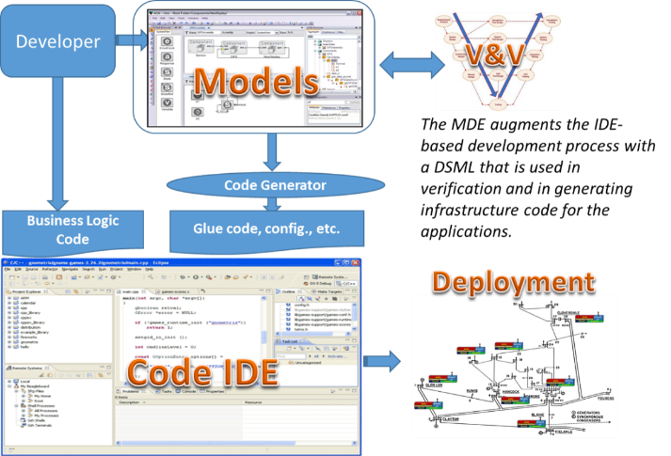
Overview – Key ideas
Resilient Information Architecture Platform for Smart Grid:
Foundation: A Robust, Trusted, Open Software Platform for Smart Grid.
Tools: A Suite of Model-driven Development Tools for building and integrating software applications to run within the smart grid network.
Why?
Change the paradigm for smart grid software development
Software Platforms reduce complexity and increase reliability of software applications by providing reusable technological building blocks
Model-driven development tools and processes automate the tedious parts of software development and provide a design-time framework for analysis of software systems – reducing errors

Slide 10
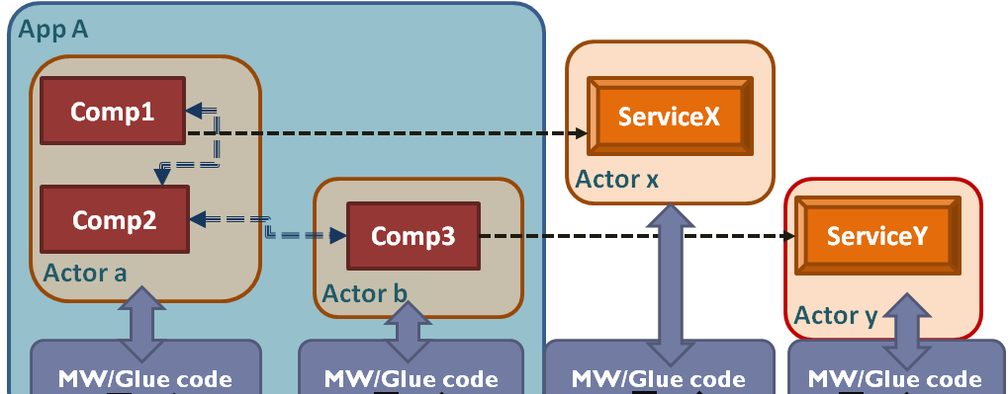
Actor Based Design
Actor-based design of applications
Apps are architected as one or more actors that share information via secure messaging
Actors encapsulate components, with well-defined interaction semantics
Actor’s resource needs are declared by developer, admitted by the system integrator; and enforced by the platform
Why?
The components encapsulate reusable functionality
The actor concept provides ‘units’ for computing activities, communication via secure information flows, resource usage, and fault tolerance

Slide 11
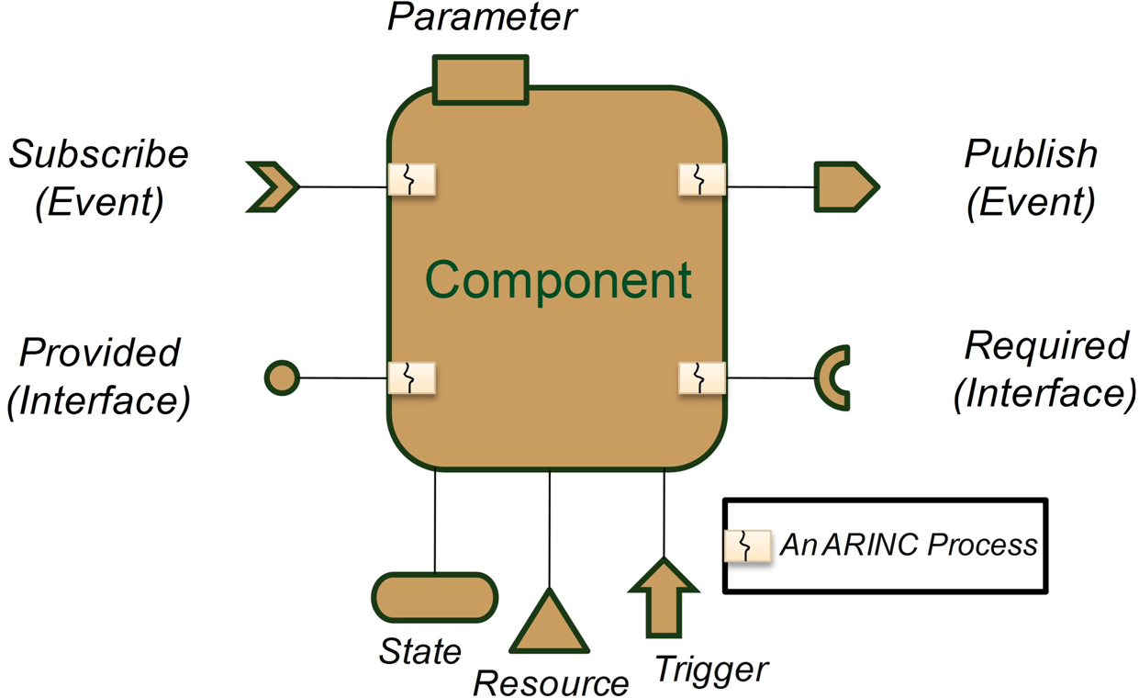
Components
A component is the basic building block of an application.
Asynchronous publisher (subscriber) interface:
Pushes (receives) a message
Performs computation in response to a message
Synchronous provided (required) interface:
Handles incoming requests or makes outgoing requests.
Other interfaces allow state management, resource management and provide support for “time-triggered” operations.

Slide 12
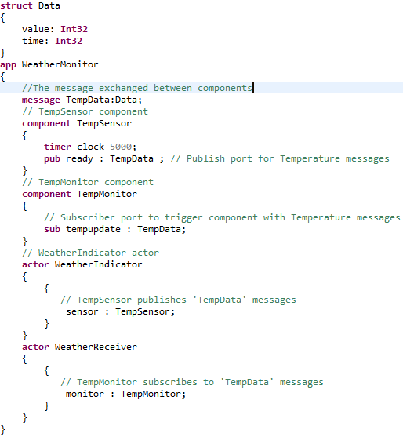
Components
Temp
Sensor
Temp
Monitor
Pub/Sub
A Weather Monitor
Application
Periodic
Timer

Slide 13
Components
Components communicate via messages.
Every message has an associated data structure
Temp
Sensor
Temp
Monitor
Pub/Sub
A Weather Monitor
Application
Periodic
Timer

Slide 14
Components
Components can be triggered via timers.
Temp
Sensor
Temp
Monitor
Pub/Sub
A Weather Monitor
Application
Periodic
Timer

Slide 15
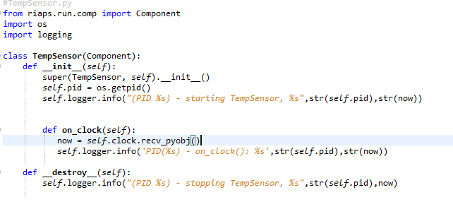
Components
Components can be triggered via timers. Each timer is associated with a function that describes the operation to be performed with the timer fires.
Skeleton of the code is automatically generated by the RIAPS development environment

Slide 16
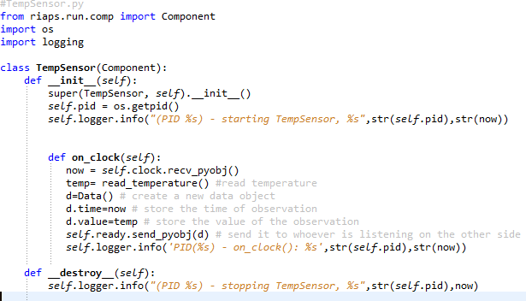
Components
Components can be triggered via timers. Each timer is associated with a function that describes the operation to be performed with the timer fires.
Development updates the code to add the operations to be performed

Slide 17
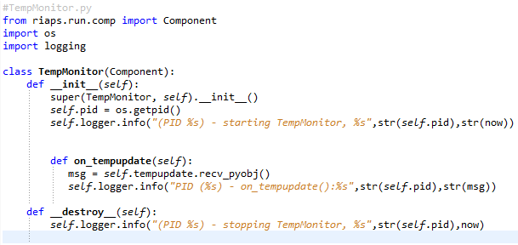
Components
Another developer can write what to do when the message arrives
Skeleton of the code is automatically generated by the RIAPS development environment

Slide 18
Components
- Actors provides resource and fault encapsulation.
- They are similar to processes in other operating systems

Slide 19
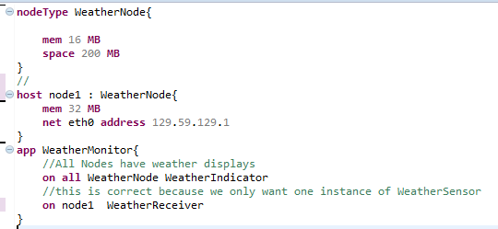
Components
- Actors provides resource and fault encapsulation.
- They are similar to processes in other operating systems
Actors are also the unit of deployment.

Slide 20
Extended Demonstration

Slide 21
